Slide 1
STATISTICS CASE STUDY SUBMISSION
Group Name:
N.Srinivas & DDA1610009
Naresh Gunjalli & DDA1610210
Abhishek Parikshya & DDA1610
Pramod Illuri & DDA1610086

Slide 2
<Objective of the Analysis>
The analysis is being done for a loan lending company, which wants to understand the driving factors behind loan default .
The company will utilize the outcome of this analysis for its portfolio and risk assessment.
The company wants to determine which driver variables are having the most influence on the tendency of loan default.

Slide 3
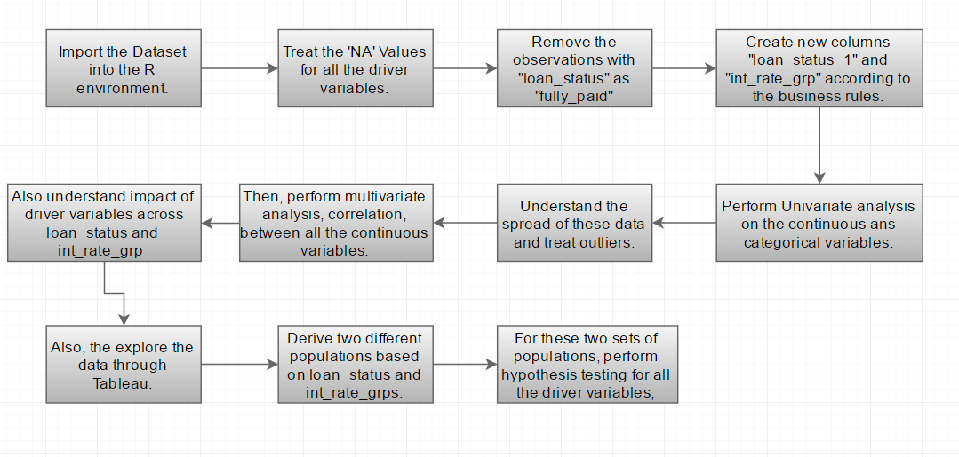
<Problem solving methodology>

Slide 4
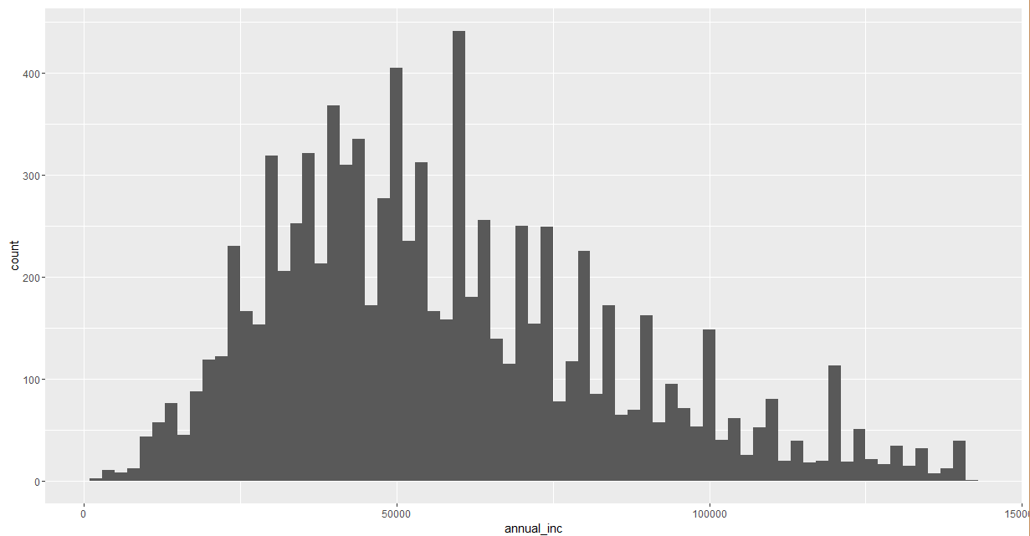
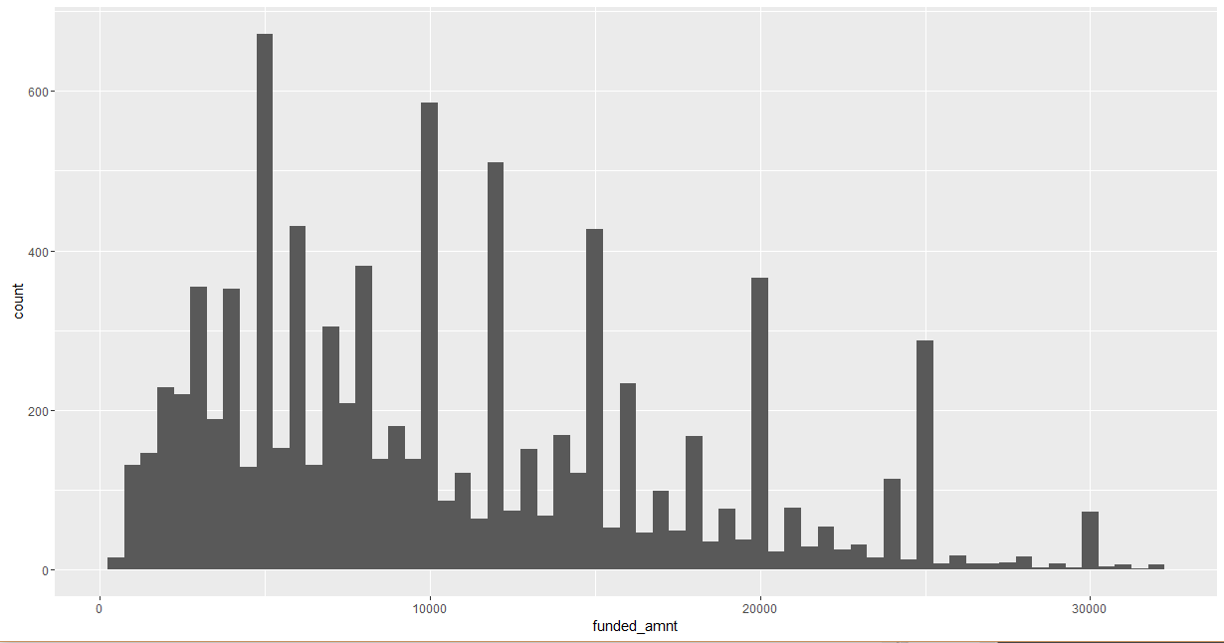
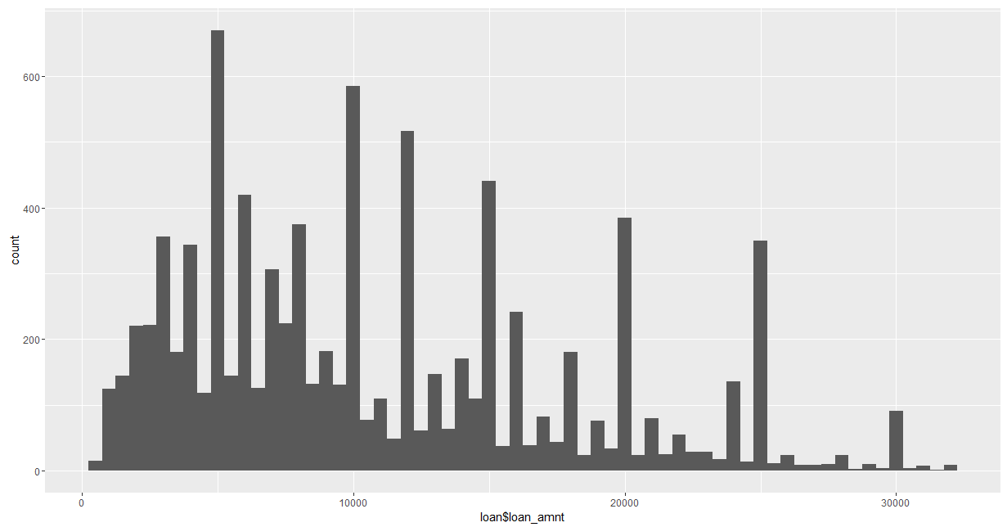
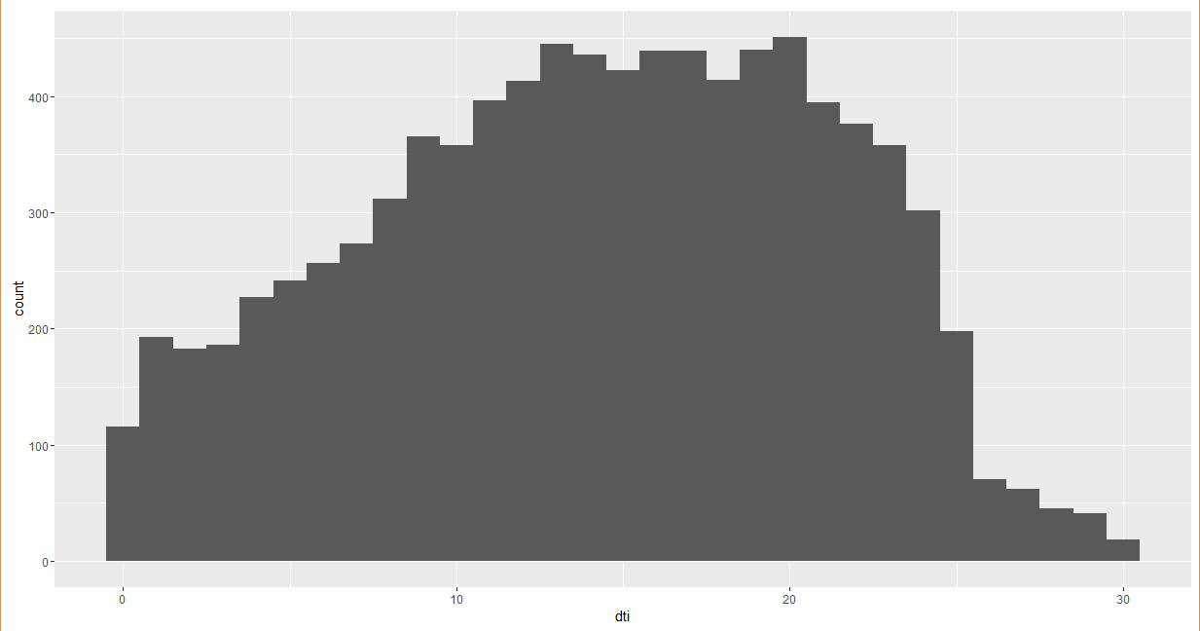
<Univariate Plots – continuous variables>

Slide 5
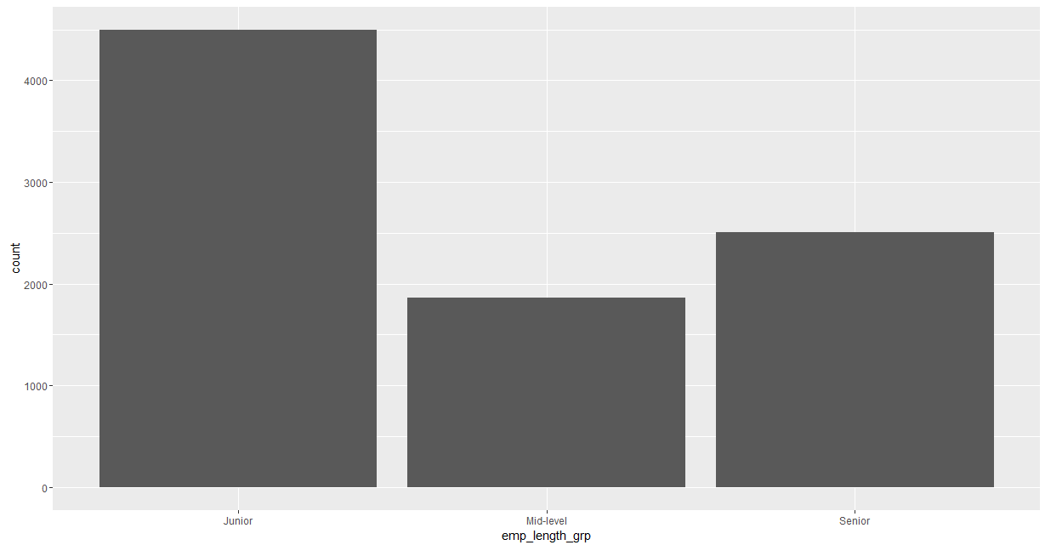
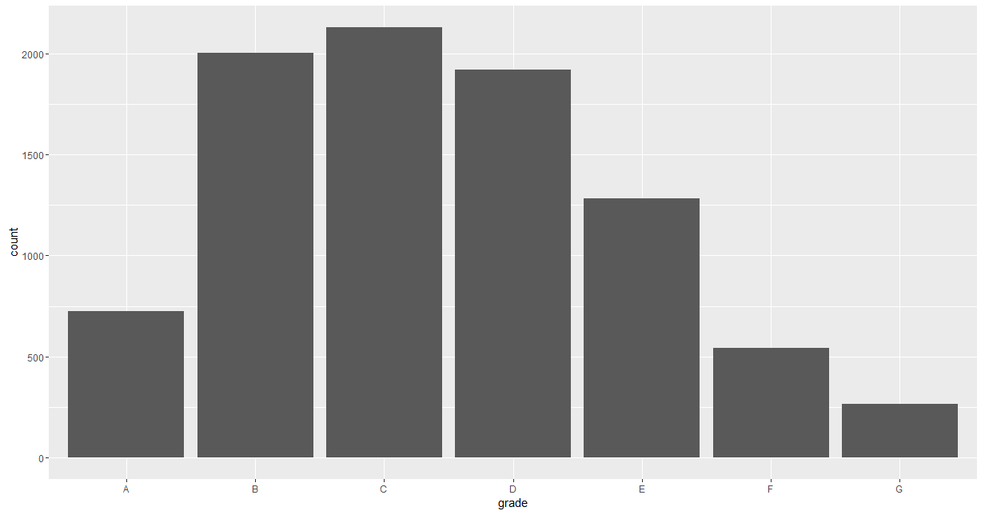
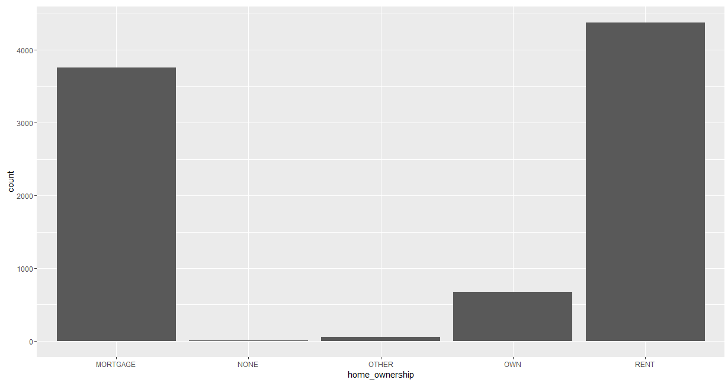
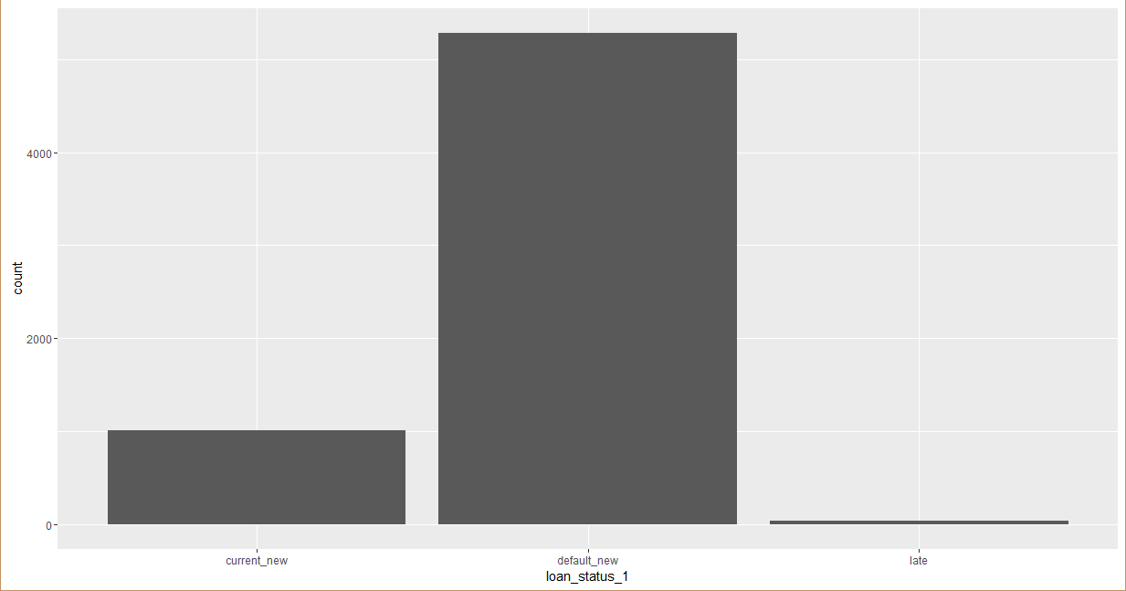
<Univariate Analysis – Dimensional Analysis>

Slide 6
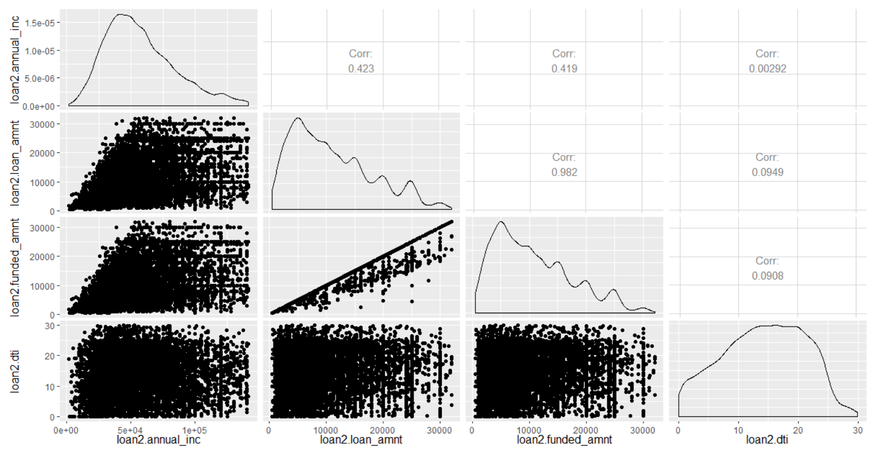
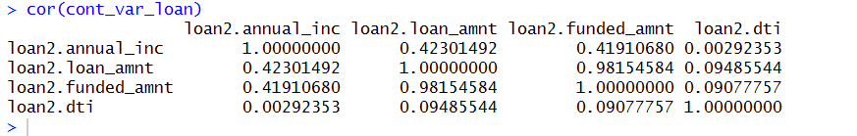
<Multivariate Analysis – Continuous Variables>

Slide 7
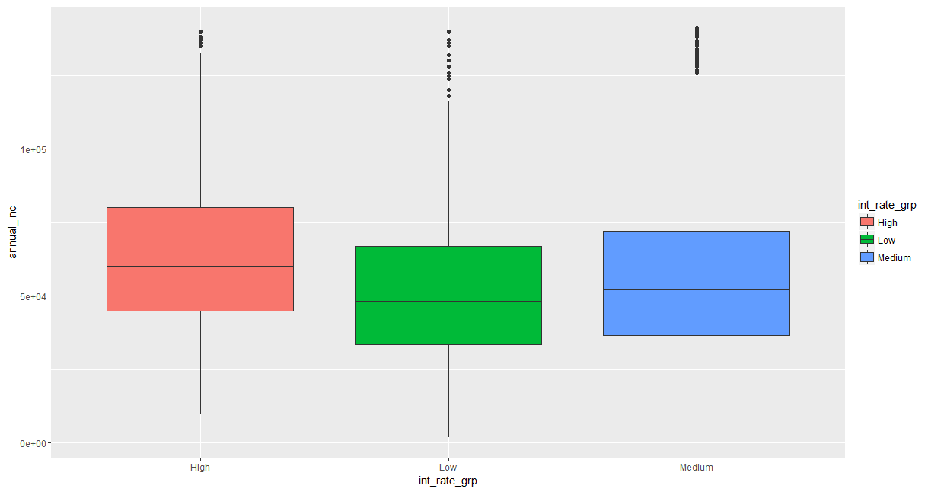
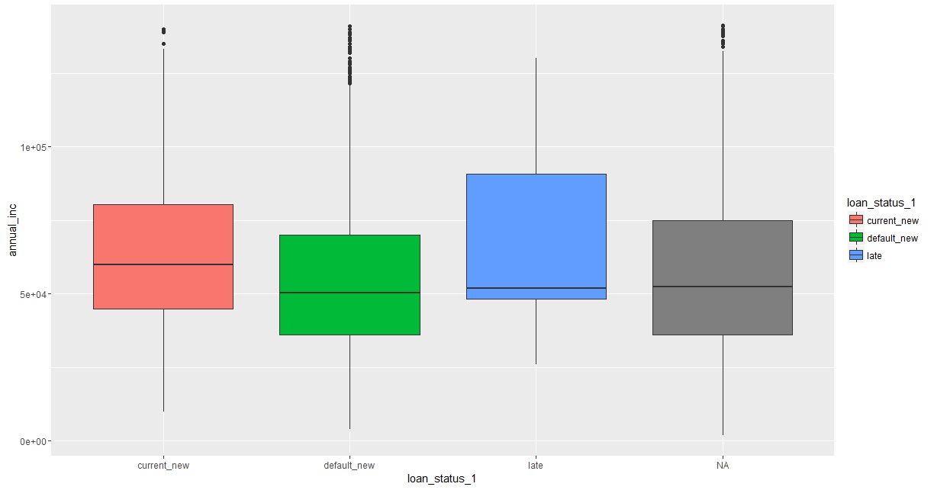
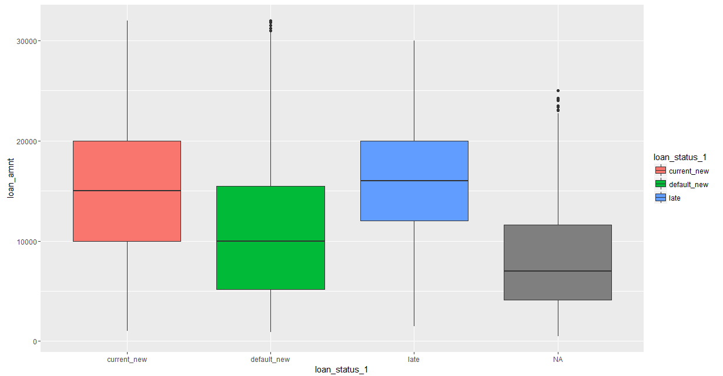
<Multivariate Analysis – Categorical Variables>
Mean annual_income of people in current_new is higher implies loan is already being given to people with a higher annual income.
The late payments distribution is skewed. Which shows most higher annual_income people have a tendency to delay payment.
We get an interesting insight that, on an average the defaulted loan amounts are lesser compared to the ones in current and late stages.
Interest rates given by the bank seem to be proportional to the annual_inc.
Interest rates given by the bank seem to be proportional to the loan amount as well.

Slide 8
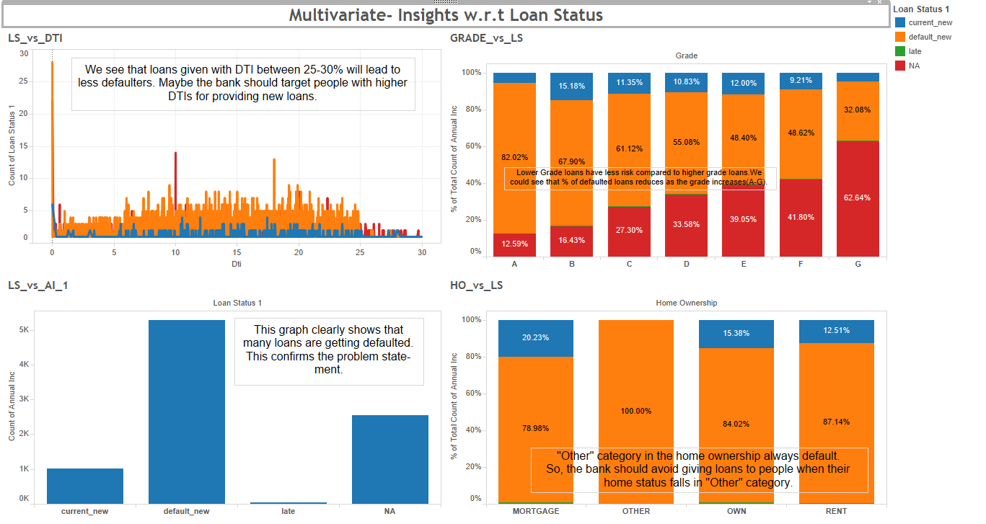

Slide 9
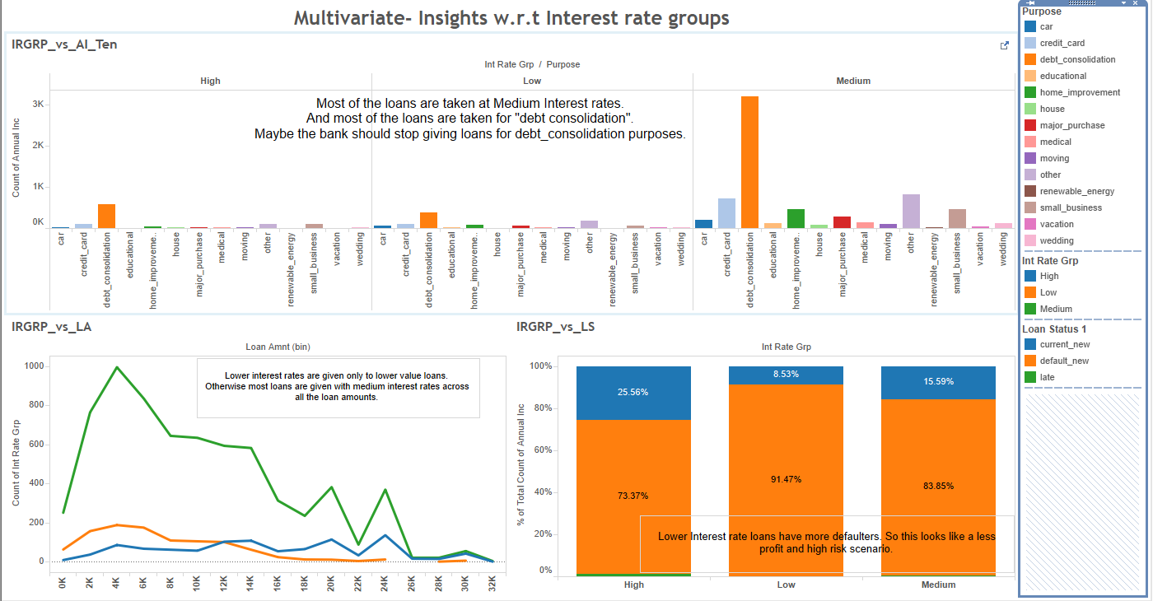

Slide 10
<Conclusions>
Lower Interest rate loans have more defaulters. So this looks like a less profit and high risk scenario.
The company is already providing more loans to the higher income group. But from our multivariate analysis, we find that the higher income group has a tendency to make late payments.
Most of the loans that are taken for "debt consolidation” purposes are defaulted.
The company should avoid giving loans to people when their home status falls in "Other" category, as they tend to default 100%.
We see that loans given with DTI between 25-30% will lead to less defaulters. Maybe the bank should target people with higher DTIs for providing new loans.
Lower Grade loans have less risk compared to higher grade loans. We could see that % of defaulted loans reduces as the grade increases(A-G).

